Slide 1

Image Data - Recognizing Handwritten Alphabets using machine learning

Slide 2
About us
Data science combines different subjects like math, statistics, and computer science. This means data scientists can work in various industries like healthcare, finance, marketing etc. Many companies need data scientists because they have a lot of data that they want to understand and use to improve their business. So, there are plenty of job opportunities available
Presented by
Member 1: Mohd Ashfaq
Qualification : B.Com Computers
Experience : Fresher
Member 2 : Shaik Sultan
Qualification : B.Com Computers
Experience : Fresher

Slide 3
Objectives
Aim and scope of the project
Aim of the Projects :
To detect custom hand written alphabets
To get better results using Random forest Regression, logistics Regression and other required models
Scope of the Project:
The scope of the project is improvise the accuracy in recognizing and making image processing learning techniques to achieve high accuracy in recognizing different alphabet characters and create a reliable system for automated alphabet recognition

Slide 4
Project details
MNIST DATA SET
DATA PROCESSING
IMAGE RESIZE
CONVERT INTO
NUMPY ARRAY
FLATTENING IMAGE
TRAIN_TEST
SPLIT
SPLIT DATASET
MATPLOTLIB
LIBRARY
DATA ANALYSIS
DROPING COLUMN
DATA CLEANING
BUILD MODEL
LR,RF,DT,ADA BOOST CLASSIFIER
MODEL IMAGE RECONGINITION
CLASSIFICATION REPORT
CONFUSION MATRIX
ACCURACY_SCORE
PREDICTING AND EVALUATING MODEL

Slide 5
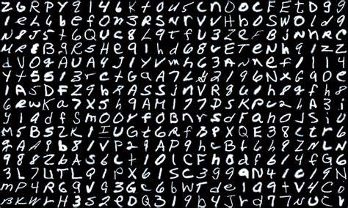
SUMMARY OF DATA
The data consisted of a large collection of handwritten alphabet images, where each image represented a single alphabet character. The dataset included diverse writing styles, variations, and noise. It was split into training and testing sets, allowing the model to learn from the training data and evaluate its performance on unseen samples

Slide 6
Exploratory Data Analysis
Data Pre-processing :
Extract the contents of the zip file into a directory on your local system.
Load the MNIST dataset using a library os.listdir() .
Importing required libraries.
Separate the data into images and labels.
Mapping them to the 26 letters of the English alphabet.
Verify if the images are properly labeled and aligned with their corresponding labels.
Data cleaning:
Resize the image using thumbnail ( 28*28 )
Convert into NumPy array
Flatten data in order to make data frame using ravel
Drop the unwanted columns
Convert data into CSV file

Slide 7
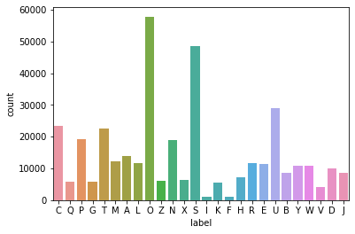
Data Analysis
NOTE : From Above graph we can observe that the “O” label have most count compared to other

Slide 8
Model buliding
We split the dataset into training and testing sets for model evaluation
Then we create train and evaluate some classifier for prediction
Classifier such as random forest , decision tree , Ada boost , logistics regression
The random forest classifier accuracy is 0.976545 which is highest
Decision tree classifier accuracy is 0.926890
Logistic regression classifier accuracy is 0.356288 which is lowest
Ada boost classifier accuracy is 0.537530
Kneighbors classifier accuracy is 0.582335
Random forest classifier
Decision Tree classifier
Logistic Regression classifier
Ada boost
classifier
Kneighbors
Classifier

Slide 9
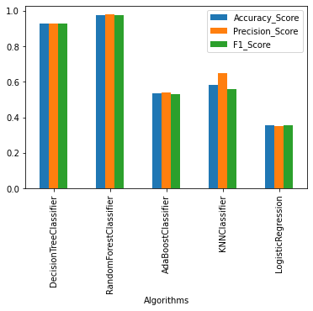
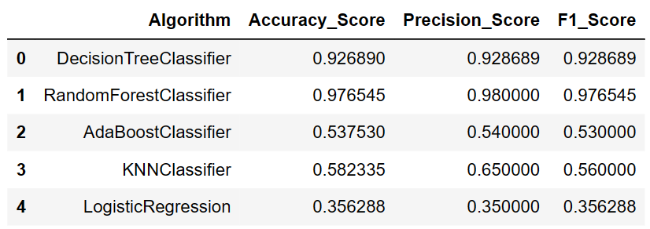
Model Evaluations
Method Compariosion Table and bar plot

Slide 10
Conclusion :
Based on the evaluations, all Five models (Random Forest, Logistic Regression, Decision Tree , Ada boost and KNN) showed promising performance in recognizing handwritten alphabets. The Random Forest Classifier and DecisionTree classifier are models achieved top two position compare to other and both of them near to each other
The Random Forest Classifier emerged as the best-performing model, offering accurate classification results. The trained model can be deployed in real-world applications, contributing in tasks involving handwritten alphabet recognition

Slide 11
Conclusion (Key finding overall)
The MNIST dataset was successfully loaded and preprocessed.
The images were resized to a common size and converted into numerical vectors.
The labels were transformed from numerical format to letter format, mapping them to the 26 letters of the English alphabet
No missing values or significant anomalies were found in the dataset.
Data analysis has been done in which letter “O” was having high count
The Random Forest Classifier achieved the highest accuracy and F1-score (0.976545 & 0.976545 ), making it the most suitable model for recognizing handwritten alphabets
The trained model can be deployed in real-world applications, contributing with efficiency in tasks involving handwritten alphabet recognition

Slide 12
Key Business Question
What is the accuracy and performance of the machine learning model in recognizing handwritten alphabets from the MNIST dataset?
How does the recognition model compare to human accuracy in identifying handwritten alphabets?
What is the potential business value or impact of implementing the handwriting recognition model?
How can the model be deployed and integrated into existing systems or processes that require handwritten alphabet recognition?

Slide 13
Experience/Challenges Faced
Challenges Faced
During the project, challenges may have been encountered related to data preprocessing, model selection.
Unzipping and storing the value was difficult
To improve the model's performance, data augmentation techniques and ensemble methods could be explored.
Due to all categorical columns unable to perform more plots and graphs
Models has taken long time to execute
Experience
We evaluate the model's performance using various metrics and analyze the results.
If the model performance is not satisfactory, we can make improvements by adjusting hyperparameters or exploring different techniques

Slide 14

THANK YOU

